Slide 1

GTM strategy in India for Artist-driven indie cultural app
Sanchita Mohanty - UEMF24009

Slide 2
Introduction
Introduction
500K+ artists, yet no authentic digital space
Traditional art lost in the noise of algorithms
Cultural events scattered, hard to discover Quote: “My art deserves more than just likes.” — Classical Sitar Artist, Pune
Introduction

Slide 3
Market Potential
$250M Indian art market, 19% YoY growth
1M+ cultural enthusiasts, collectors, event-goers
90% of digital users prefer content in regional languages
28,000+ Indian musicians active on Spotify Source: Hurun Art List, Statista, Spotify India.

Slide 4

INTRODUCING
India’s Cultural Heritage Community
Artist-first cultural app
Showcase. Collaborate. Earn.
Traditional meets digital: with dignity

Slide 5
Who Are We Building For?
Professional Artist (age 25–45)
Emerging Creative (age 22–35)
Cultural Enthusiast (age 28–50)
Institutions & Academies Quote: “Kalakshetra connects us like gurukuls once did.”

Slide 6
Brand Positioning
"India’s Authentic Digital Cultural Platform"
Verified. Curated. Rooted.
Depth over dopamine

Slide 7
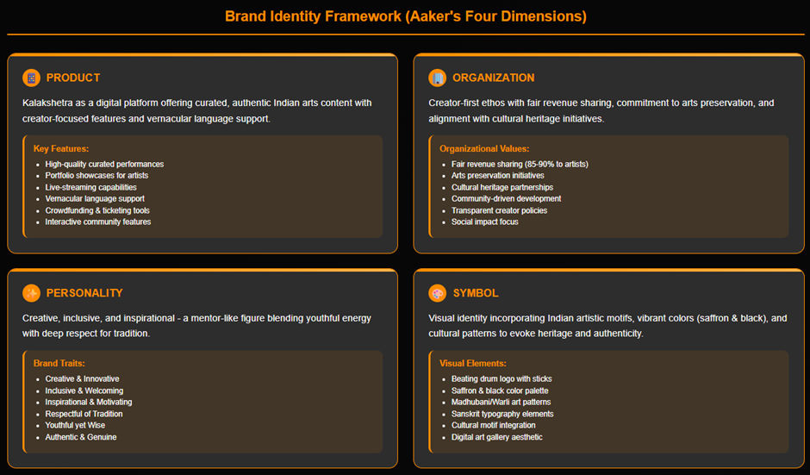

Slide 8
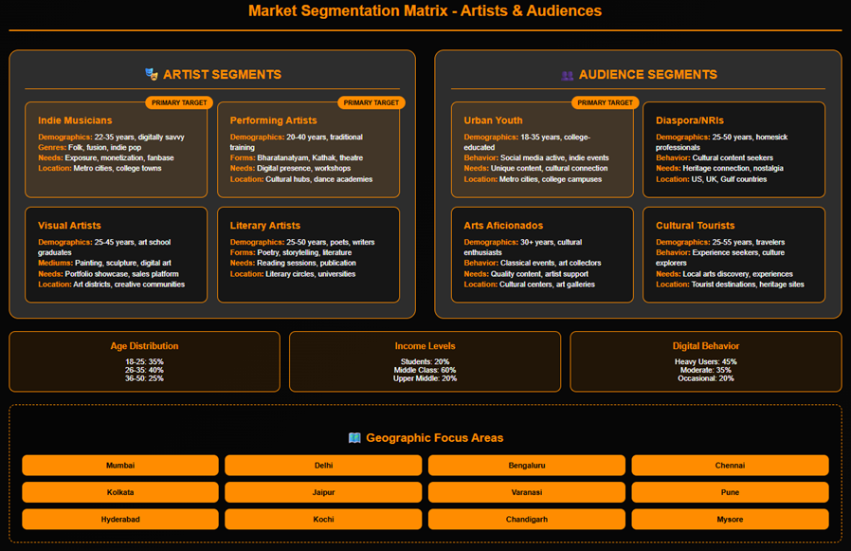

Slide 9
Core Features
Artist Portfolios & Galleries
Cultural Event Discovery (Map view)
Collaboration Hub
Real-time Messaging & Tips
Workshops + Commissions

Slide 10
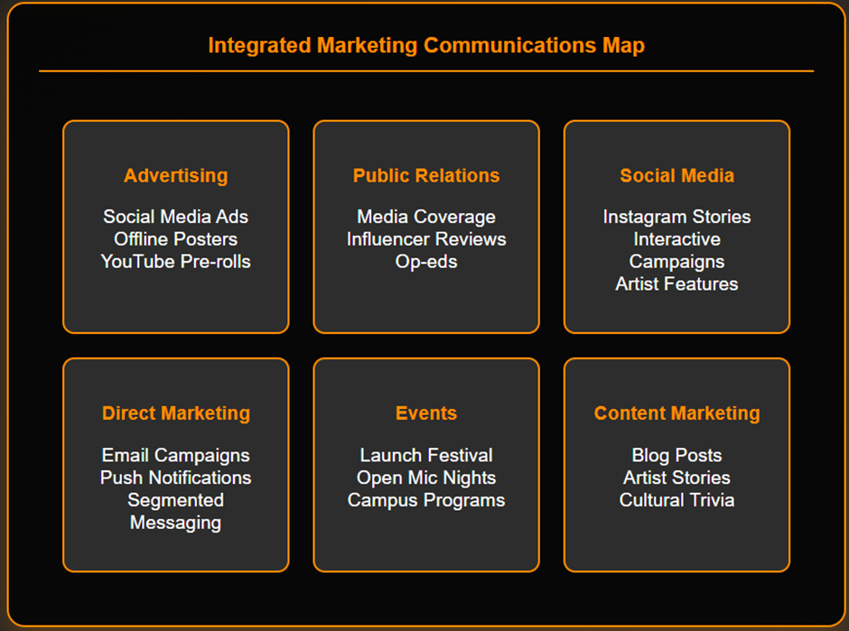

Slide 11
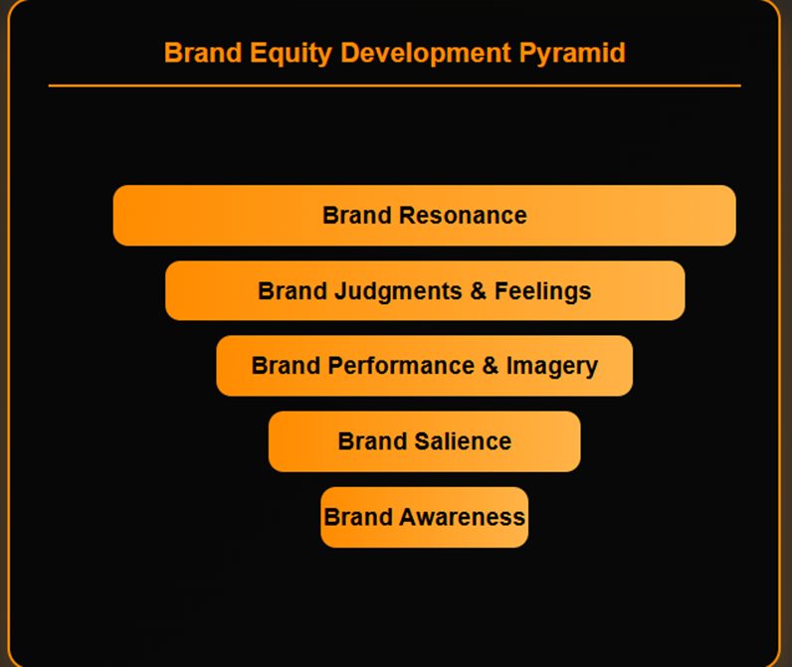

Slide 12
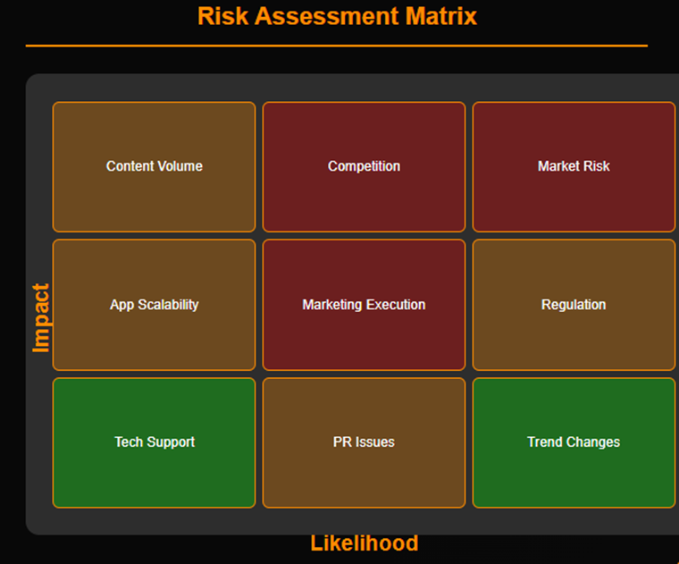

Slide 13
Core Features
Artist Portfolios & Galleries
Cultural Event Discovery (Map view)
Collaboration Hub
Real-time Messaging & Tips
Workshops + Commissions

Slide 14
Go-To-Market Rollout
Phase 1: 1,000 verified artists (5 cities) – Invite-only
Phase 2: 5,000 artists – Mentor referrals + local language
Phase 3: 15,000 artists – National & diaspora expansion

Slide 15
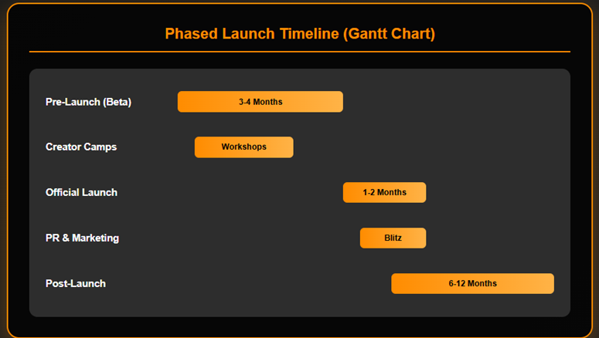

Slide 16
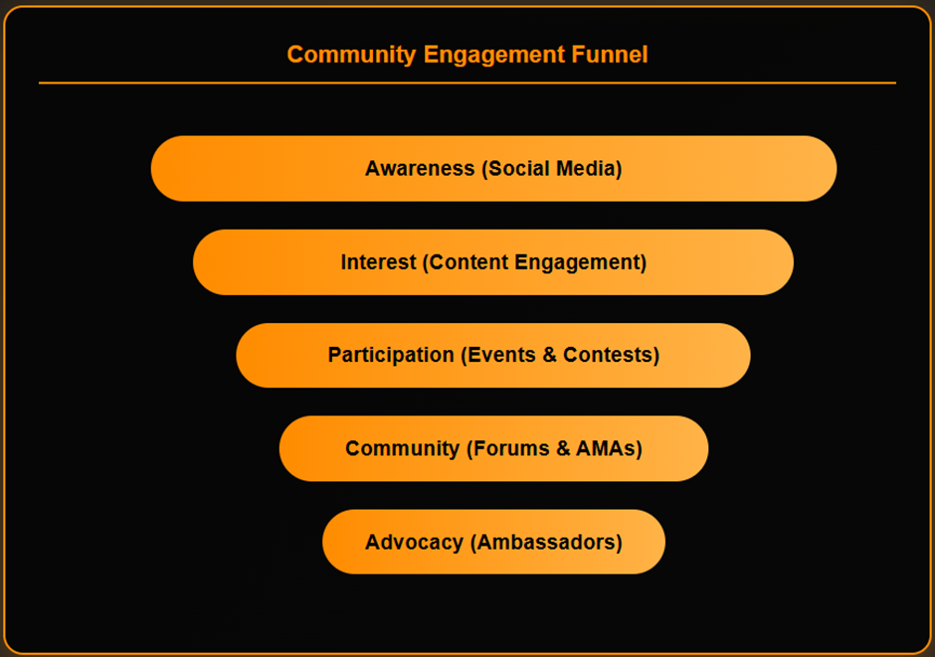

Slide 17
Screens from Kalakshetra (Development)
Feed View: Trending & Nearby
Event Listings: Classical Music, Craft Bazaars
Artist Profile: Tip Jar, Skills, Gallery

Slide 18
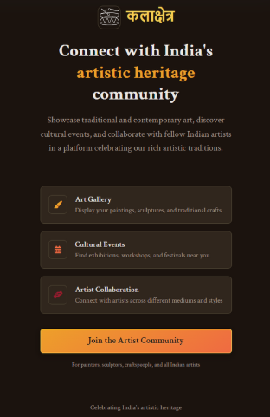
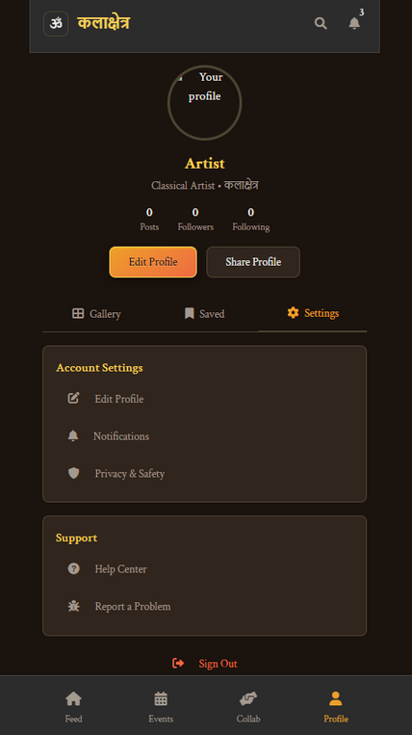
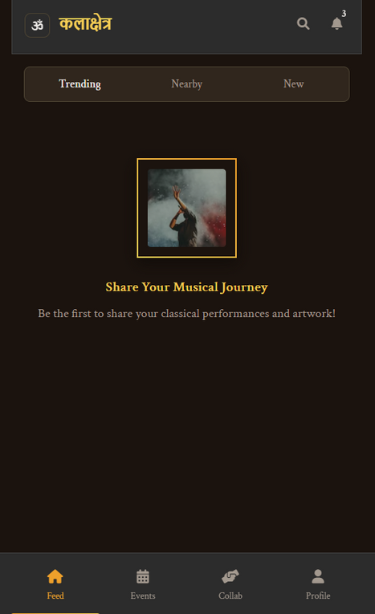
https://6e7dab31-dcfb-4faa-8497-e8373f6fb72a-00-3kpxxs2aowrp2.picard.replit.dev/

Slide 19
Partnership-First GTM
Cultural Boards (Sangeet Natak Akademi, IIC)
Festivals (Kala Ghoda, India Art Fair)
Art Schools (Sir JJ, NIFT, Kalakshetra Foundation)
Artist Ambassadors

Slide 20
Monetization Strategy
Free Tier: Basic profile, event discovery
Pro Artist: ₹499/mo – commissions, analytics, shop
Institution: ₹2,999/mo – bulk profiles, branding, tools

Slide 21
Success Metrics (Year 1 Targets)
2,000 Verified Artists
25,000 Monthly Active Users
₹50L ARR
60% Monthly Retention

Slide 22
Why Kalakshetra Wins
Platform | Cultural Focus | Monetization | Verification
Kalakshetra | ✅ | ✅ | ✅
Instagram | ❌ | ❌ | ❌
Behance | ❌ | ❌ | ❌

Slide 23
Risk Mitigation
Small market? Focused high-value users
CAC? Leverage trusted institutions

Slide 24
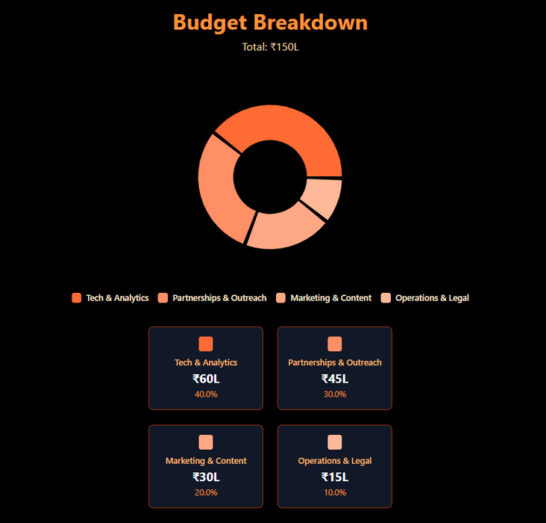
Budget Allocation (Year 1: ₹1.5 Cr)
Tech & Analytics: ₹60L
Partnerships & Outreach: ₹45L
Marketing & Content: ₹30L
Operations & Legal: ₹15L

Slide 25
Visual Identity
Logo: कलाक्षेत्र
Colors: Saffron, Black, Deep Grey
Fonts: Mukta / Sahadeva

Slide 26
Let’s Collaborate
Join our cultural mission
DM for walkthroughs, partnerships, feedback
Website: [insert link]
#Kalakshetra #CulturalTech #PMIndia #HeritageMeetsProduct

Slide 27
References & Acknowledgements
Hurun India Art Report 2024
Spotify for Artists Data (2023)
Statista (Indian Event Economy)
Interviews: Artists, faculty, beta users
App Screens: Kalakshetra (Internal Beta)
Festival photos: Unsplash / official archives

Slide 28
Thankyou

